Slide 1

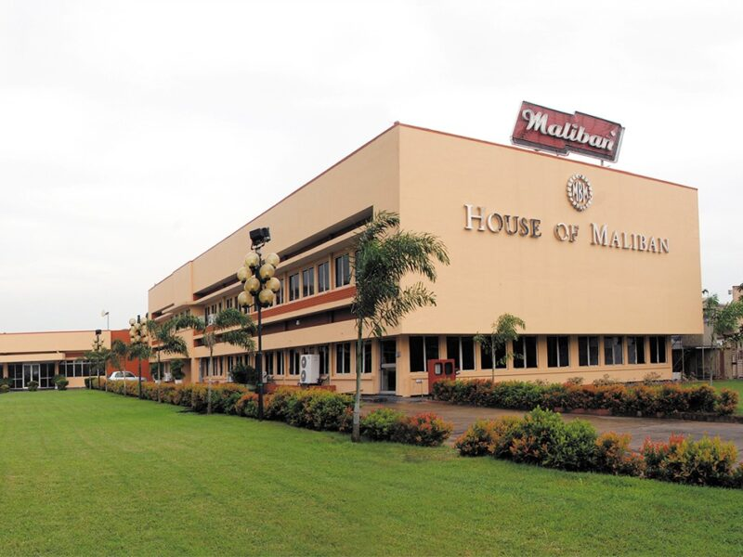
Maliban Biscuit Manufactories (PVT) Limited
(Ratmalana)
Kaviduni Seramika (218031)
Department of Food Science & Technology
Wayamba University of Sri Lanka

Slide 2
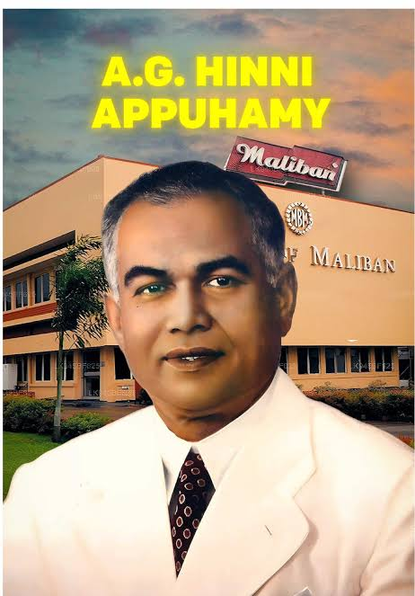
Company Overview
01
"No biscuit not worthy to feed your own children should leave the gates of Maliban to feed the world." – A.G. Hinni Appuhamy
  Maliban was founded in 1935 by Mr. A. G. Hinni Appuhamy, who built the company from a small local venture into a leading food manufacturer in Sri Lanka.
  In 1954, Maliban Biscuit Manufactories (Pvt) Ltd. was established as Sri Lanka’s first mechanized biscuit factory.
  Today, it produces 25 million biscuit packs per month and exports to 40+ countries worldwide.
  The company operates under internationally recognized food safety and quality management systems.

Slide 3
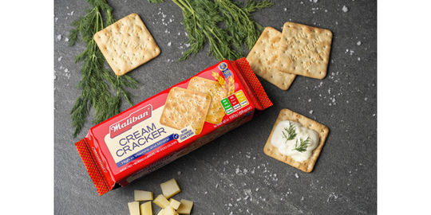
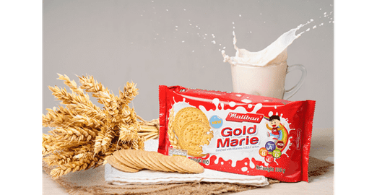
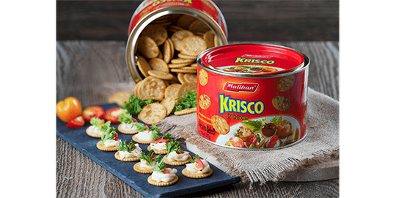
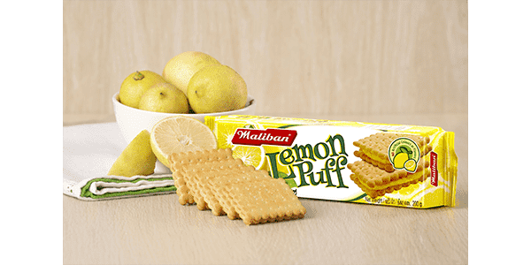
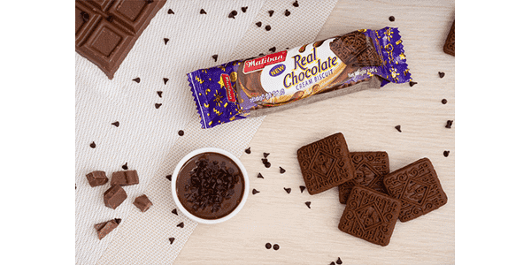
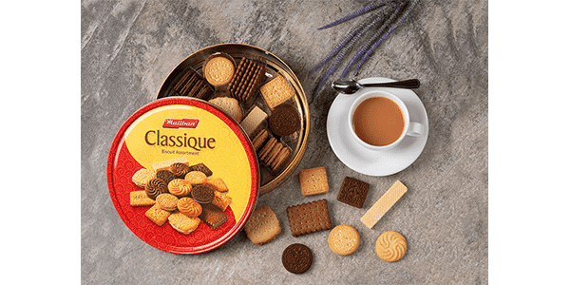
02
Product Portfolio
Quality Is The Best Thing We Follow
Cracker Range
Sweet Range
Savoury Range
Puff Range
Cream Range
Gift Assortment Range

Slide 4
03
Objectives
To gain practical exposure to industrial biscuit manufacturing processes, including production operations, quality assurance systems, and food safety standards (GMP and GHK) at Maliban Biscuit Manufactories (PVT) Ltd.
To understand real-time factory workflow and strengthen knowledge of food production practices through active involvement in industrial operations and quality control activities

Slide 5
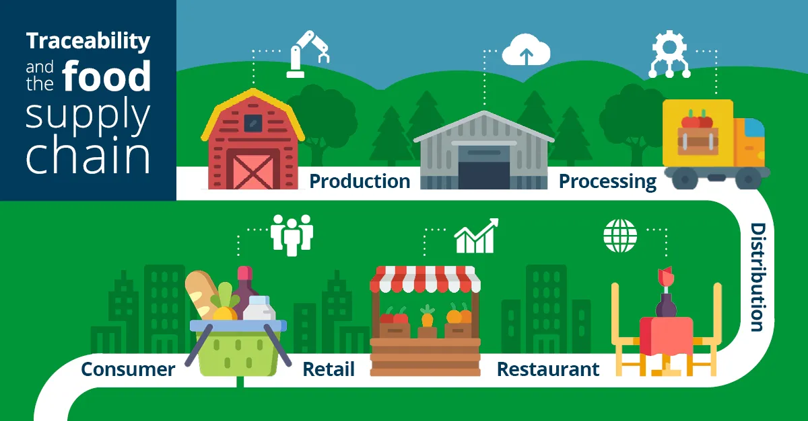
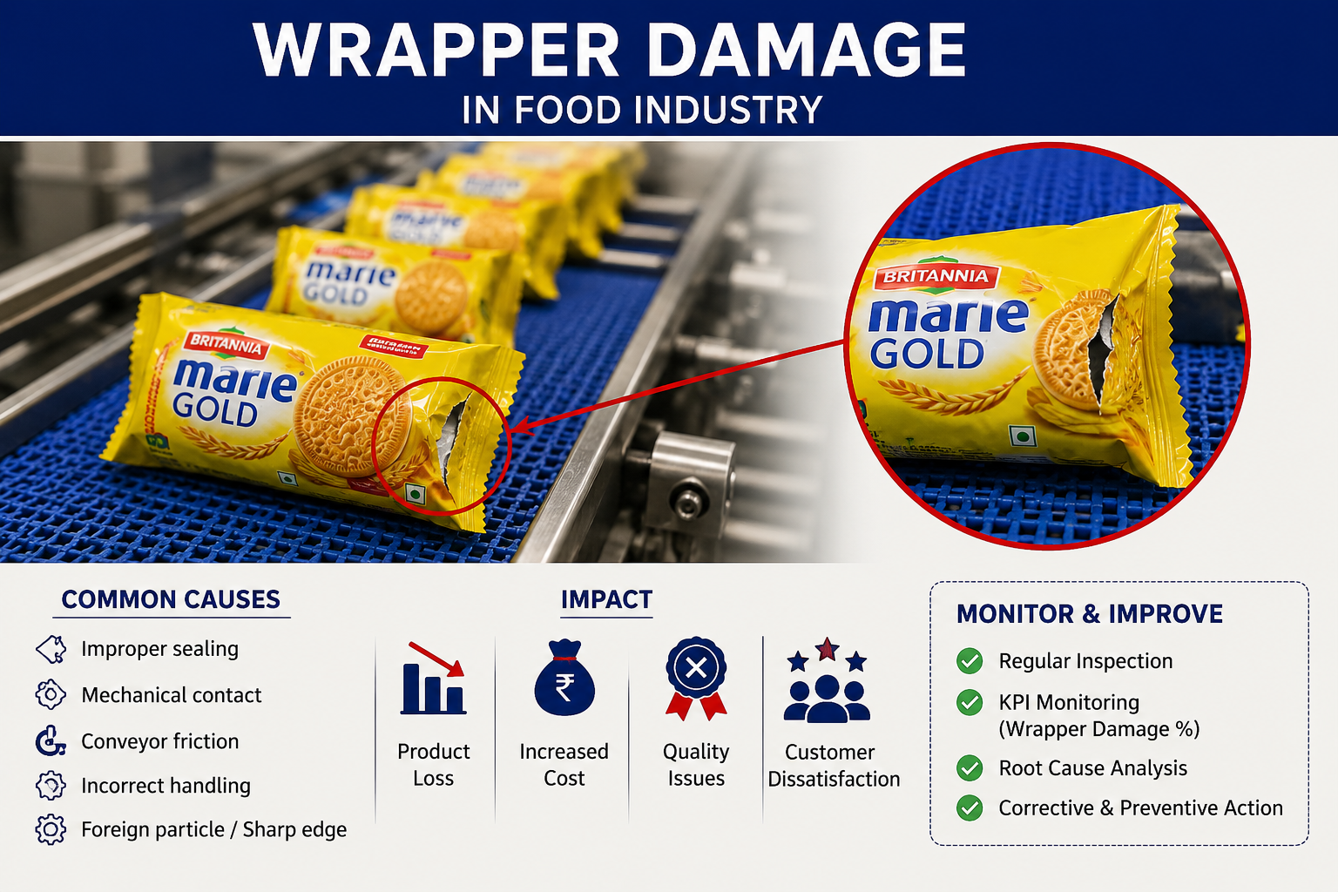
04
Training Activities
Traceability Training – Traced Cream Scrap and Lemon Puff through the production process to understand product traceability and recall procedures.
Wrapper Damage KPI Monitoring – Collected and analysed wrapper damage data to identify loss trends and support improvements in packing efficiency.
Chilled Water & Dough Temperature Monitoring – Monitored chilled water and dough temperatures to evaluate their relationship and maintain consistent dough quality during mixing.

Slide 6
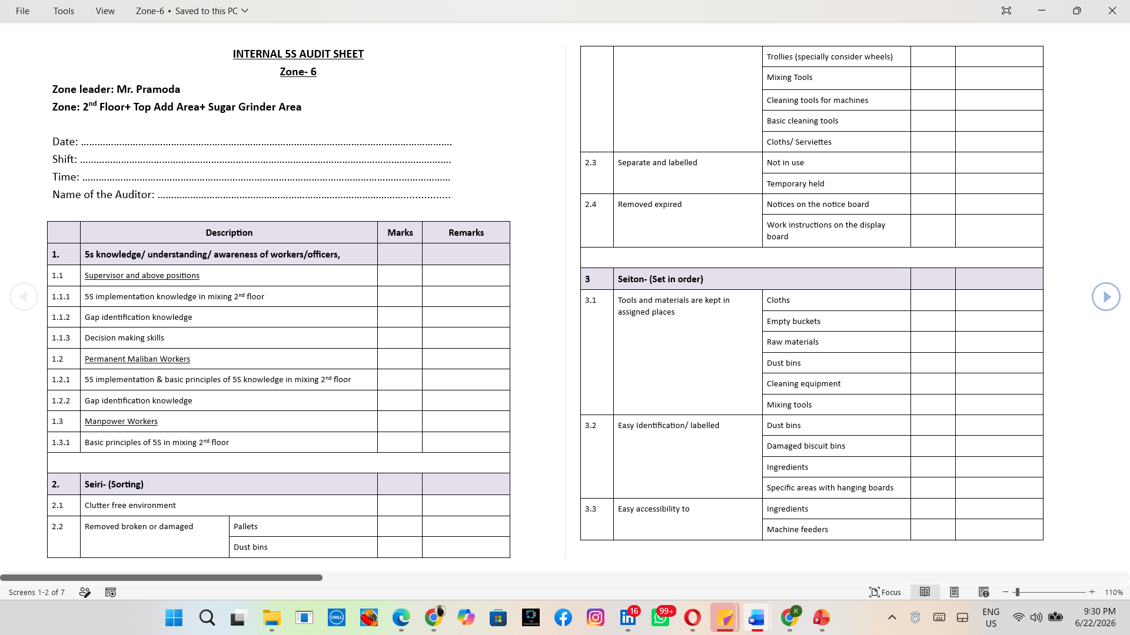
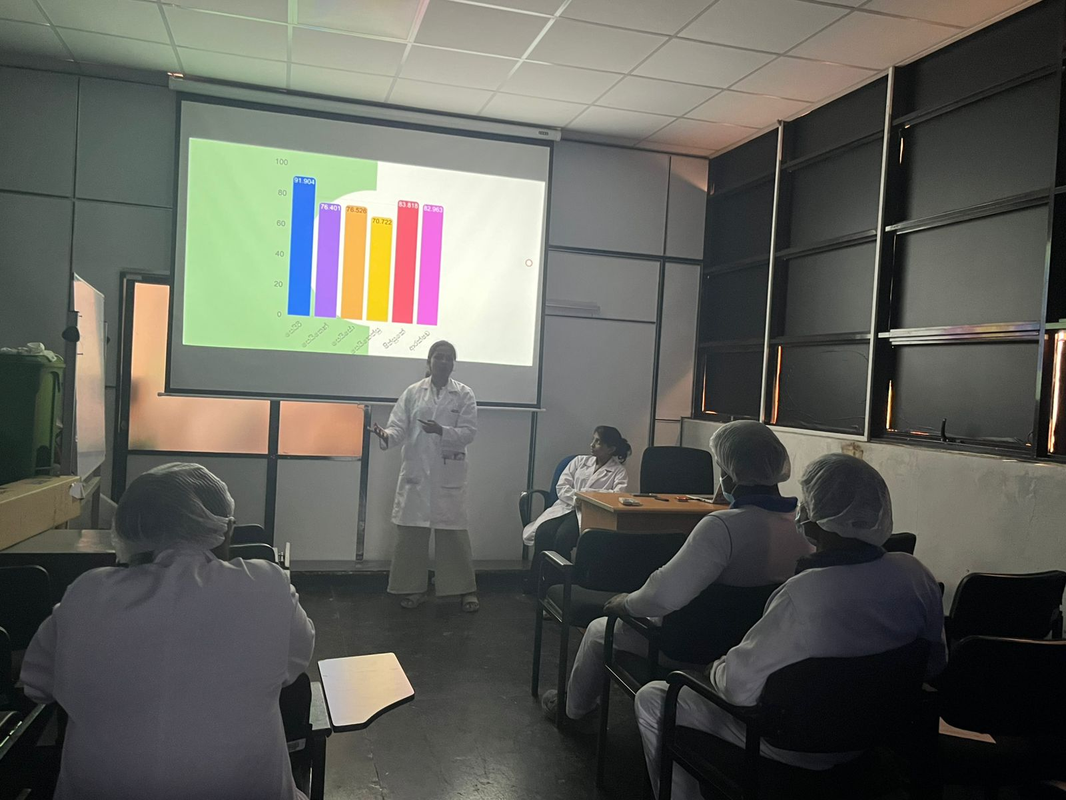
Projects Undertaken
05
  Assessment of GMP, GHK & Personal Hygiene Violations
Objective
To evaluate the implementation of Good Manufacturing Practices (GMP), Good Housekeeping (GHK), and personal hygiene practices in the Mixing Section and identify opportunities for continuous improvement.
Activities Performed
Developed a 5S-based audit checklist for the Mixing Section.
Conducted GMP, GHK, and personal hygiene audits.
Identified improvement areas and recommended corrective actions.
Conducted operator awareness and training programs on GMP and 5S practices.
Prepared standardized audit sheets for future monitoring and continuous improvement.

Slide 7
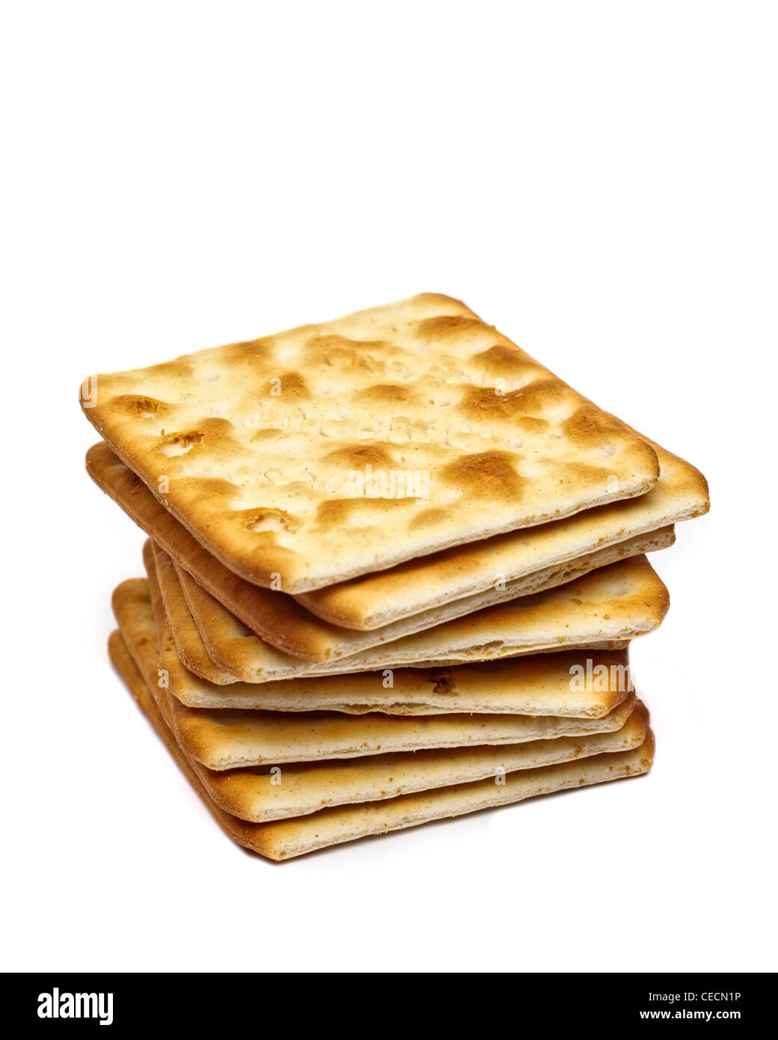
06
2. Flour Quality Evaluation for Biscuit Dimensions
Objective
To evaluate the relationship between flour quality characteristics and the dimensional consistency of Cream Cracker and Cracker Buddy biscuits.
Activities Performed
Identified biscuits with increased breadth beyond the specification.
Collected flour quality reports and biscuit dimension data from production records.
Reviewed scientific literature on the relationship between flour rheological properties and biscuit dimensions.
Analysed the relationship between the flour resistance-to-extensibility ratio and biscuit breadth.
Compared the analytical results with the specified flour quality range.
Communicated the findings to the relevant department to support corrective actions and maintain product consistency.

Slide 8
07
Key Learning Outcomes
  Comprehensive understanding of the industrial biscuit manufacturing process.
  Practical application of GMP, GHK, 5S, and food safety principles in a production environment.
  Experience in data collection, KPI monitoring, and statistical analysis for process improvement.
  Ability to perform root cause analysis using quality tools such as Pareto and Fishbone diagrams.
  Enhanced problem-solving, teamwork, communication, and professional workplace skills.
  Ability to bridge academic knowledge with real industrial practices.

Slide 9
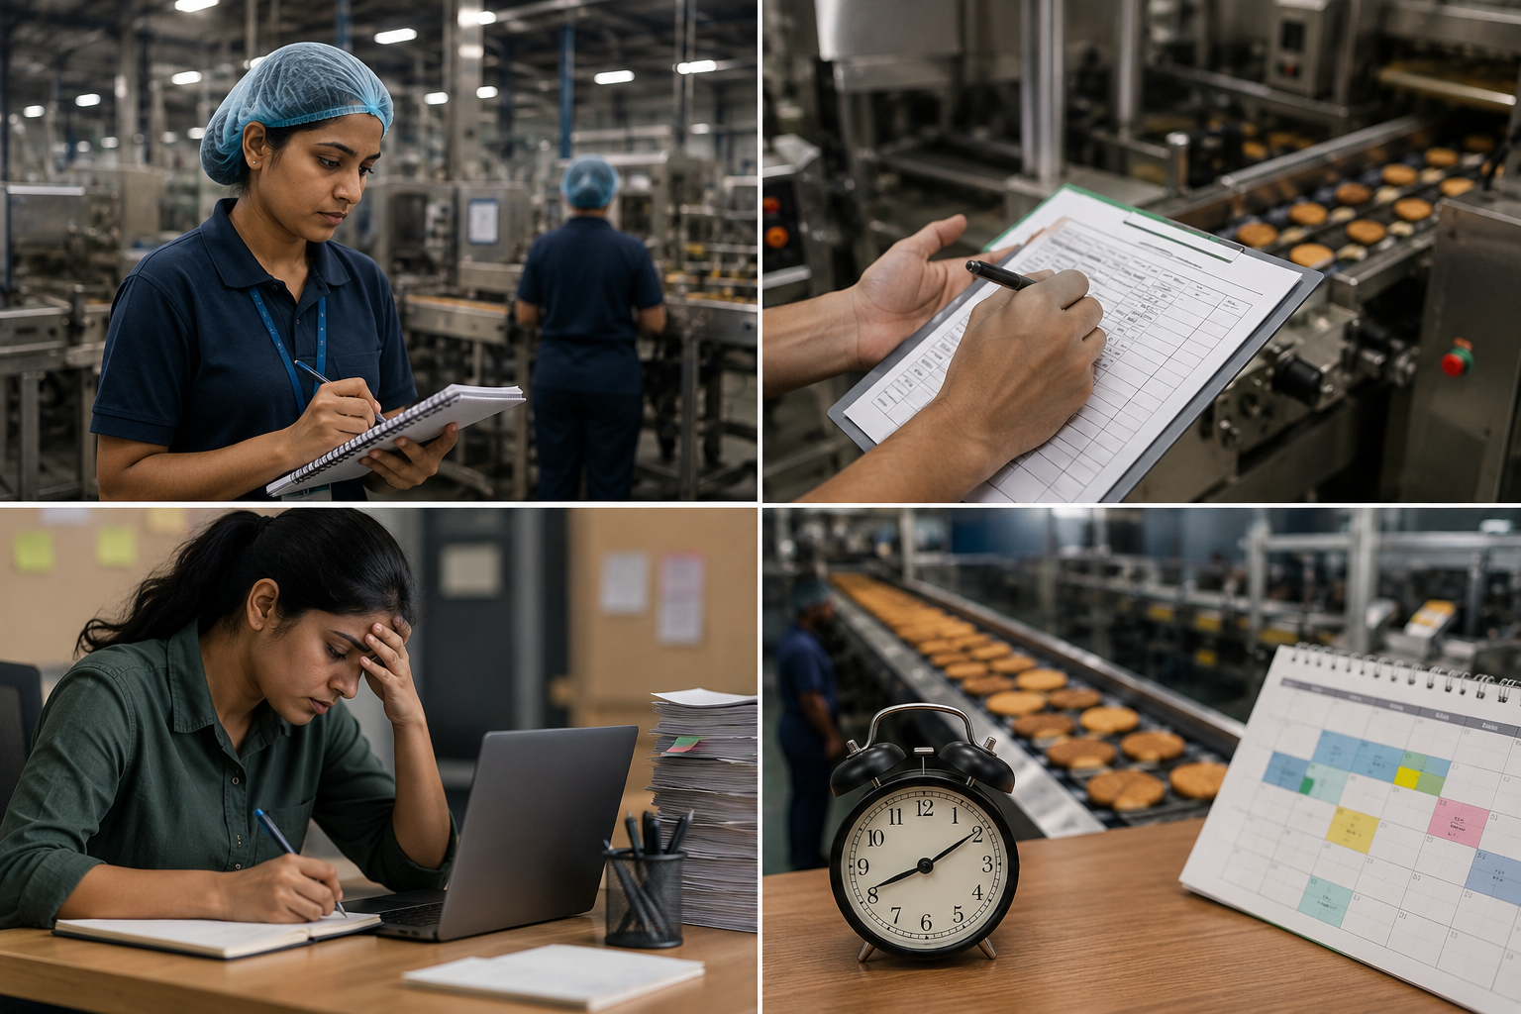
08
Challenges Faced
Adapting to a fast-paced industrial environment
Collecting production data within operational constraints
Managing time alongside multiple project activities
Working around continuous production schedules

Slide 10
SWOT Analysis
09
Strengths | Weaknesses | Opportunities | Threats
Strong brand reputation and market leadership in Sri Lanka | High dependency on raw material price fluctuations | Expansion into new international markets | Intense competition from local and international biscuit manufacturers
Extensive distribution network covering over 100,000 retail outlets | High energy and operational costs associated with large-scale manufacturing | Development of innovative and healthier product varieties | Rising costs of raw materials, packaging materials, and utilities
Export presence in more than 40 countries | Production losses due to packaging defects and process inefficiencies | Adoption of advanced automation and digital manufacturing technologies | Changes in food safety regulations and compliance requirements
Strong quality assurance and food safety management systems | Manual practices in certain operational areas leading to human errors | Growing consumer demand for convenient snack foods | Supply chain disruptions affecting raw material availability
Diverse product portfolio catering to different consumer segments | Challenges in maintaining consistent GMP and housekeeping standards across all production areas | Continuous improvement initiatives to reduce waste and increase productivity | Economic instability and fluctuations in consumer purchasing power

Slide 11
10
Acknowledgement
  Mr. DN Liyanage, S/L, Dept. of Food Science & Technology, Wayamba University of Sri Lanka
  Mr. C Priyankara, Head of Production, Maliban Biscuit Manufactories (Pvt) Ltd.
  Mr. P Hettiarachchi, Manufacturing Excellence Manager, Maliban Biscuit Manufactories (Pvt) Ltd
  Mrs. T Edirisooriya, Formula and Receipt Manager, Maliban Biscuit Manufactories (Pvt) Ltd

Slide 12
11
Thank You….

